Slide 1
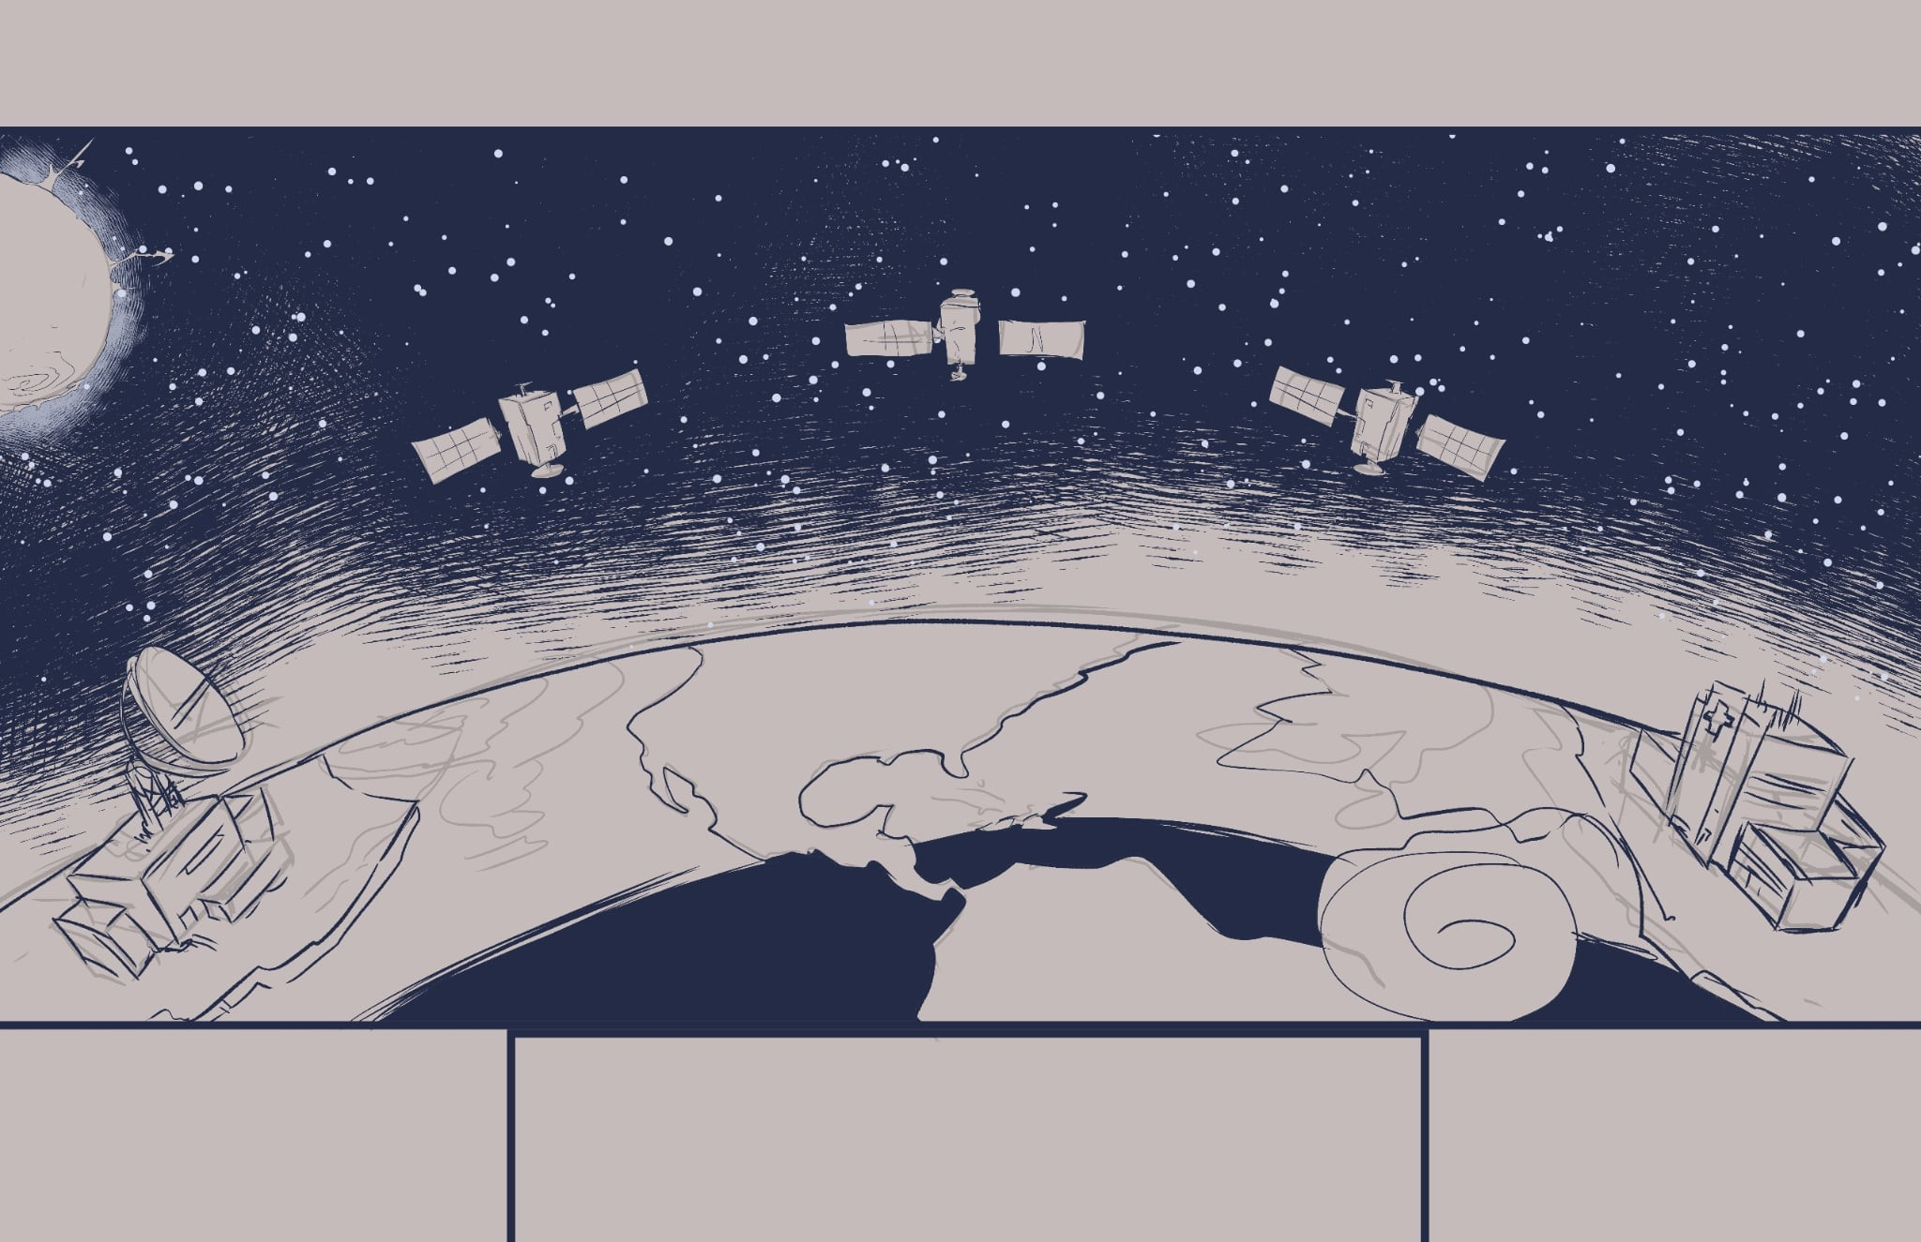
Modeling Autonomous Satellite Decision-Making in Contested Environments
The Challenge: Ground-Centric Operations
Problem: Relies on constant, vulnerable ground station links.
Impact: Significant decision latency from data round-trips.
Vulnerability: Ineffective when communications are jammed or lost.
The Solution: MEO Edge Processing
Concept: Perform data processing and analysis directly on the satellite.
Benefit: Radically reduces latency by enabling real-time, on-board decisions.
Outcome: Creates a more autonomous, resilient, and cost-effective constellation.
The Payoff: Quantified Mission Impact
Metric 1 (Latency): Measures the precise reduction in sensor-to-decision time.
Metric 2 (Autonomy): Assesses the satellite's ability to operate independently.
Metric 3 (Efficiency): Quantifies bandwidth savings and data quality improvements.

Slide 2
Data Buckets:
A - AI/ML (OPSSAT-AD v2)
C - Comms (OPS-SAT/NORAD 44878)
E - Environmental (NASA OMNI High-Res Space Environment Data)
Simultaneity – where the data overlaps.
Current Simultaneity Window:
28 Jan. 2022
17:42-17:55 UTC
AI/ML Telemetry
Data
ESA OPS-SAT
Dataset.csv
Segments.csv
Overlap
Communications
Data
SatNOGS OPS-SAT
Telemetry
OPS-SAT/NORAD 44878
“Simultaneity”
28 Jan. 2022
17:42-17:55 UTC
ESA OPS-SAT (A+C Only)
Overlap
Overlap
Environmental Context of A and C
Environmental
Data
NASA OMNI High-Res Space Environment Data

